Slide 1


Amazon Product Review Analysis
Project By :
Group 4
Aishwarya , Amit , Neelam , Tanmay
DSFT - 8
Notes:
Source images : Powerpoint Stock Images

Slide 2

Our Data
What categories we chose and why?
Our Dataset Consists Of Around 16 Years Of Data Across Two Different Categories :
Beauty
Health And Personal Care
Beauty & personal care collectively account for 36% of the most frequently bought products on Amazon.
They also hold around 23% and 17% of total sellers on Amazon who have products listed in them.
Notes:
Source images : Powerpoint Stock Images

Slide 3

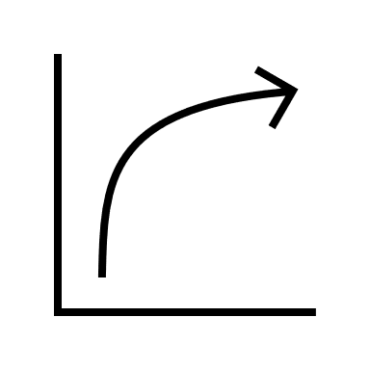
Objective a What are we looking to achieve?
To examine sentiments and keywords over time in order to understand the customers satisfaction level.
Identify the brands and categories with highest negative feedback and understand the reasons behind that.
Analyse the customer sentiment trend towards each products at macro and micro – level.
Important factors that influence people's decisions to purchase or recommend
Notes:
Source images : Powerpoint Stock Images

Slide 4
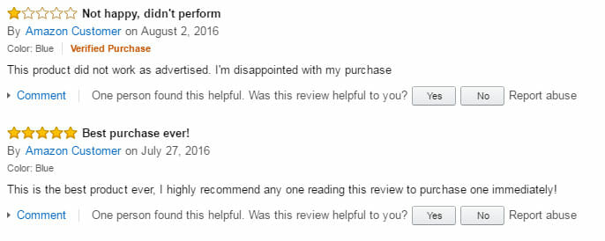
Project Need Why are we doing this ?
Before making a purchase, it has been found that most customers read product reviews.
According to survey data, 57% of Amazon customers say that positive product reviews are a key factor for purchasing (Statista, 2019).
Reviews reveal a variety of information.
Like what features and products are popular, what is in demand, what is no longer beneficial, how well the product is performing compared to its rivals' offerings, and much more.
Notes:
Source images : Powerpoint Stock Images

Slide 5

Understanding the data.
Data Pre-Processing
Exploratory Data Analysis
Classification
Clustering
Time Series Analysis
Review Analysis
Inferences
Workflow of this Project
Notes:
Source images : Powerpoint Stock Images

Slide 6

Classification
Understanding the sentiment of reviews in one word and help to built whole story. Therefore, classification of reviews is important to analyze the sentiment.
So, we have an automated system which can classify reviews sentiment into positive, negative and neutral with 85-86% accuracy.
Business Implications
These sentiments will help us filter out the brands and products falling under each sentiment.
We can further do some more analysis to understand if they have any similar characteristics, what the trend would be like for each of these sentiments and how could we tackle the undesired sentiments.
Notes:
Source images : Powerpoint Stock Images

Slide 7
Clustering
Need for Clustering
To basically make a collection of data points based on similarity and dissimilarity between them.
Model
For clustering we have used K – Means Algorithm.
Challenges
The cluster formations of other algorithms were either incomprehensible or were not giving desired results.
Business Implications
These clusters will have us filter out brands and categories with similar characteristics.
We received distinct and clear clusters for both of our datasets.
It will indirectly help us build some marketing strategies and promotional campaigns to boost sales.
Notes:
Source images : Powerpoint Stock Images

Slide 8
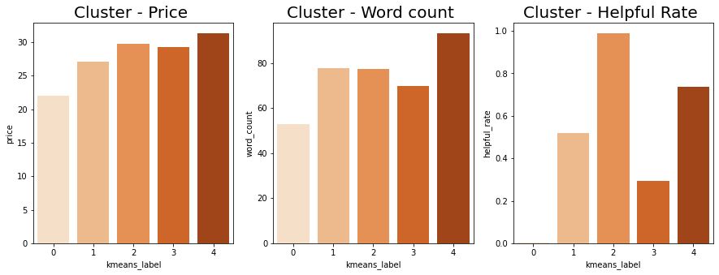
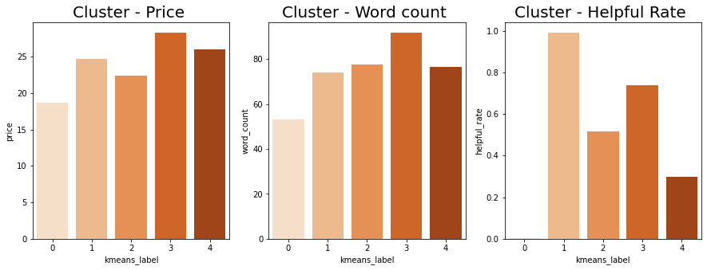
Let us see the feature wise cluster distribution
Health & Personal Care
Beauty
Price : Cluster 4 has expensive products and Cluster 0 the cheapest products.
Review Word Count : Cluster 4 has the highest word count, lowest being Cluster 0
Helpful Rate : Cluster 0 has review that were not at all helpful to the customers whereas cluster 2 had the highest helpful rate.
Price : Cluster 3 has expensive products and Cluster 0 the cheapest products.
Review Word Count : Cluster 3 has the highest word count, lowest being Cluster 0
Helpful Rate : Cluster 0 has review that were not at all helpful to the customers whereas cluster 1 had the highest helpful rate.

Slide 9
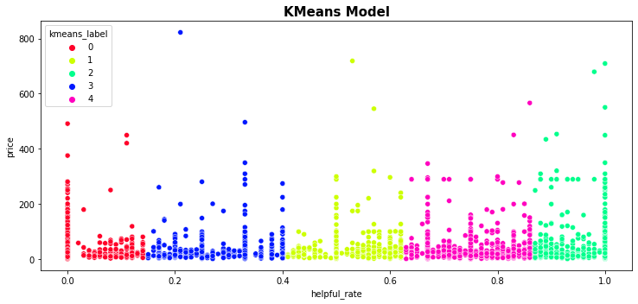
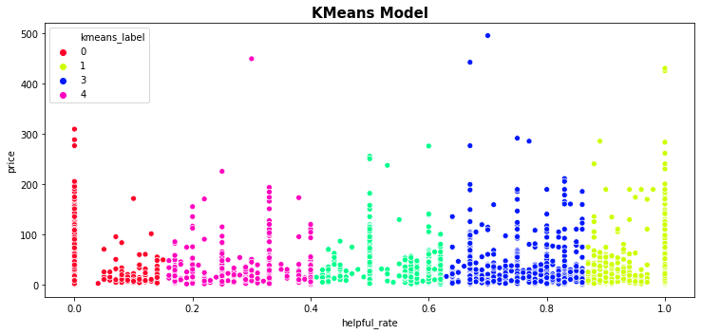

Health & Personal Care
Beauty

Slide 10

Time Series Analysis
Time series was used to predict the negative sentiment forecasting on both micro and macro level.
Need for Time Series Analysis
To observe the fluctuations of the negative reviews over a period.
Model
For Time Series , since we saw a presence of both trend and seasonality, we choose to go ahead with the SARIMA model.
Challenges
Because of the size of the dataset, we only used datapoints between the years 2010-2014 to build our model and perform analysis on macro level and on a micro level for the topmost negative sentiment product.
Business Implications
After discovering some unfavourable trend, we should study the underlying causes for the same.
Business strategies should be made, corrective measures should be taken to reduce the negative trend.
Notes:
Source images : Powerpoint Stock Images

Slide 11
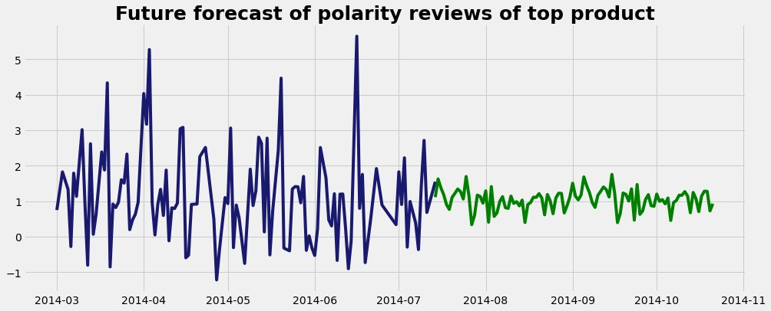
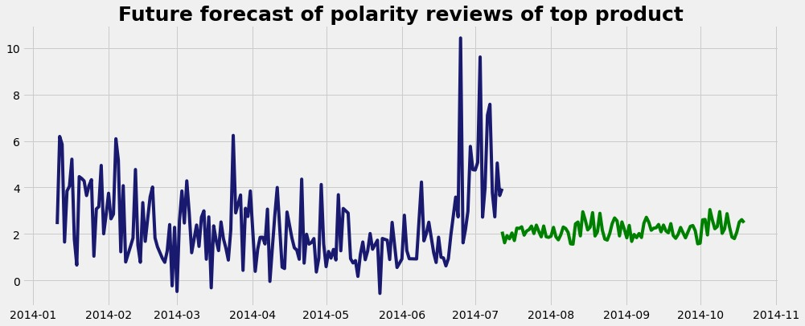
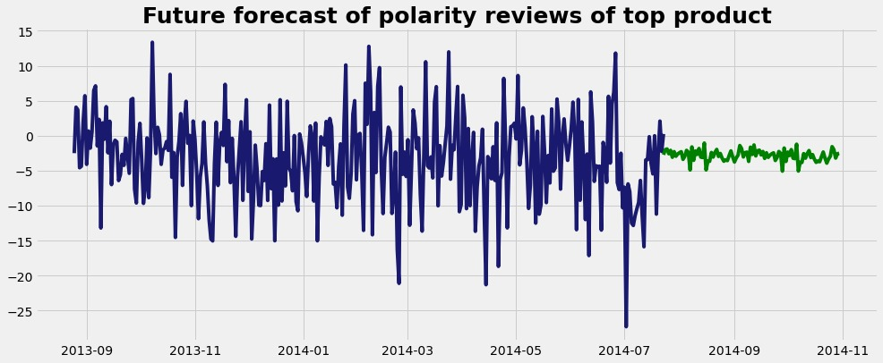
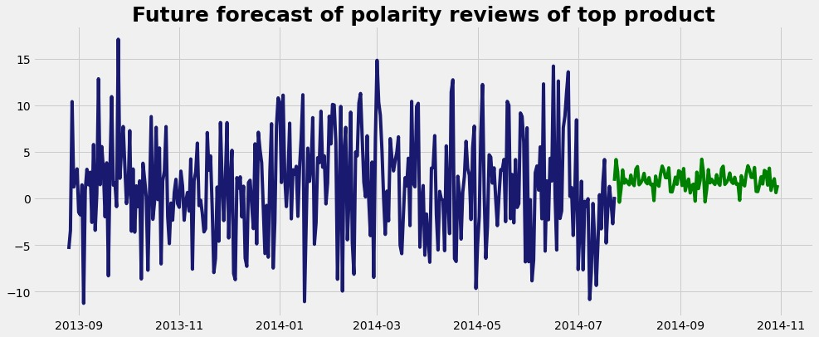
Health & Personal Care
Beauty
Future forecast for top product with most negative reviews
Future forecast for all negative reviews

Slide 12
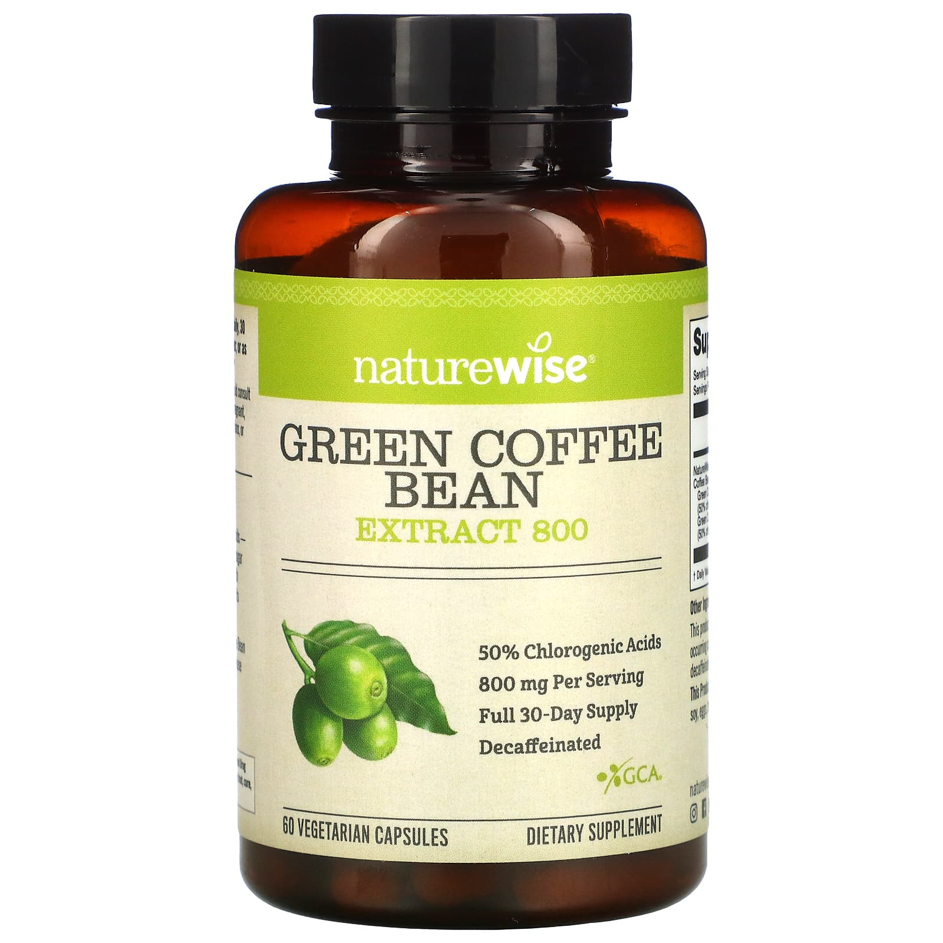

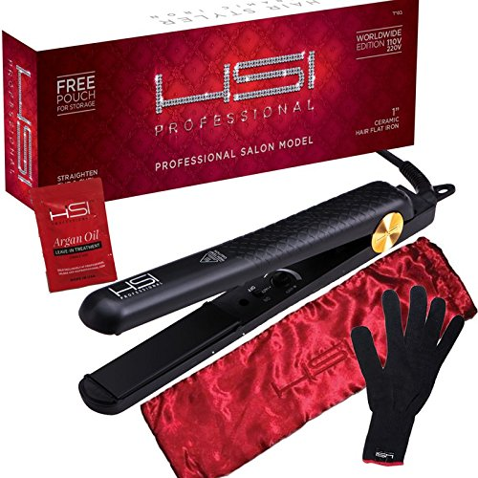
Products with highest negative sentiments.
Health & Personal Care
Nature Wise Green Coffee Bean Extract
Reason for negative reviews :
Not satisfactory as it did not fulfil the initial objective
Beauty
HSI Professional Hair Straightener
Reason for negative reviews :
Bad quality of the product

Slide 13

Review Analysis
We had around 994.177 K reviews out of which over 75% of them were positive.
We can increase the positive feedback and decrease the negative ones by monitoring few aspects of the shopping and delivery process.
We have identified some areas of concern that are heavily impacting the increase in negative reviews.
By regularly monitoring and analysing these key areas of concerns we can fulfil our goal of giving the best products and shopping experience to our customers.
Notes:
Source images : Powerpoint Stock Images

Slide 14
Key Areas Of Concern
Shipping
Fake Products
Issues with shipping :
Delayed shipping
Long shipping time
Incorrect tracking information
Issues with fake products :
Marketed as real products
Fake/dupes of originals selling on the same website.
Quality
Packaging
Issues with quality :
Poor quality products
Misleading products
Issues with packaging :
Poor quality packaging
Misleading packaging
Incorrect packaging

Slide 15
Business Inference
The company can look into each of the areas of concerns and take preventive measures to decrease customer complaints and increase customer satisfaction.
They can reach out to the brands regarding the shipping issues and quality issues.
They can also work at making the logistic department more efficient in order to enable timely fulfilment of the orders.
The company can dedicate a team to review the brands selling fake products and certify the genuine sellers. This will help them in preventing any fraudulent activities.

Slide 16
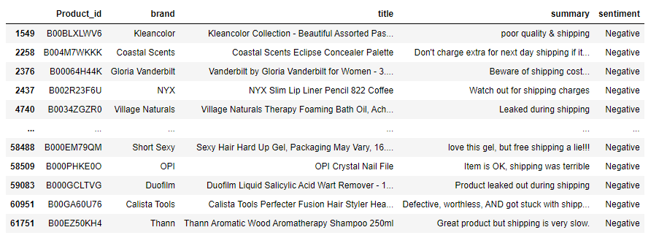
Shipping Related Issues

Slide 17
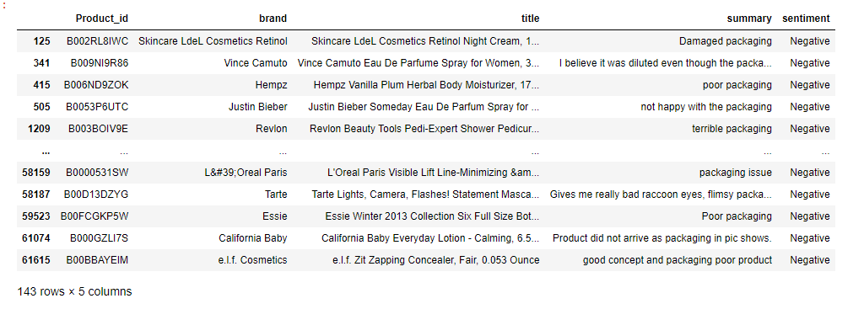
Packaging Problem

Slide 18
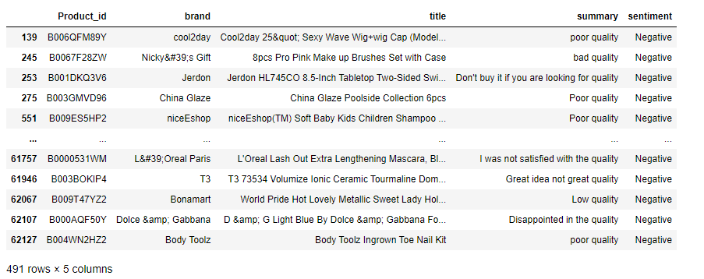
Quality Issue

Slide 19
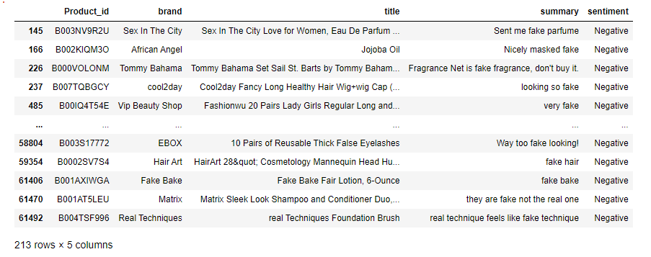
Fake Products

Slide 20
Thank You

